Slide 1




Reflection
Ivaylo Kenov
Telerik Corporation
www.telerik.com

Slide 2

Table of Contents
What is .NET Reflection?
Loading Assemblies
Extracting Information from Assembly
Unloading Assemblies from Memory
Inspecting Type Members
Extracting Methods and Their Parameters
Dynamic Method Invocation (Late Binding)

Slide 3


Reflection
What is Reflection? When is it Used?

Slide 4

What is Reflection?
The ability of a computer program to examine and modify the structure and behavior (specifically the values, meta-data, properties and functions) of an object at runtime
Reflection can be used for observing and/or modifying program execution at runtime

Slide 5
When We Use Reflection?
Reflection is used when:
Examining assemblies’ metadata
Examine assemblies’ types
Dynamically invoking methods
Dynamically creating new assemblies, executing and storing them as a file
Inspecting an object at runtime without knowing its class
The JustDecompile tool is an excellent example what .NET reflection can do

Slide 6
System.Reflection. Assembly.Load(…)
Assembly.Load(…) loads existing assembly in the .NET CLR by given
Assembly name or AssemblyName object
It searches for an assembly with the given description (probing) and loads it if it is found
If the assembly is not found throws a FileNotFoundException
Assembly.Load("SampleAssembly, Version=1.0.2004.0,
Culture=neutral, PublicKeyToken=8744b20f8da049e3");

Slide 7
System.Reflection. Assembly.LoadFrom(…)
Assembly.LoadFrom(…) loads assembly from existing local file
Takes the path to the assembly as a parameter
Reads the given file and loads it in the CLR
If the assembly is not found throws a FileNotFoundException
Assembly.LoadFrom(@"C:\Tools\MyAssembly.dll");

Slide 8
System.Reflection. Assembly – Properties
FullName – the assembly's full name
Including version, culture and key (Public Key Token)
Location – the file name from which the assembly is loaded
EntryPoint – the method by which the assembly will start (Main() method)
GlobalAssemblyCache – indicates whether the assembly is loaded from the GAC

Slide 9

Loading Assemblies
Live Demo

Slide 10
Unloading Assemblies from the Memory
.NET does not support unloading a single assembly from the memory
It is possible to unload all assemblies in an application domain
Application domains are like processes inside the CLR which can be created and destroyed
Each AppDomain has own set of loaded assemblies and runs just like separate OS process
E.g. ASP.NET uses application domains to host separate applications on the same Web server

Slide 11

The System.Type Class
System.Type
.NET Framework

Slide 12
The System.Type Class
System.Type
A starting point for inspecting .NET types
Provides access to all type members:
Fields
Methods
Properties
Events
Inner types
…

Slide 13
The System.Type Class (2)
Assembly.GetTypes() allows listing all types contained in a given assembly
Properties:
Methods:
BaseType, Attributes, FullName, IsAbstract, IsArray, IsByRef, IsClass, IsCOMObject, IsEnum, IsInterface, IsPublic, IsSealed, IsValueType, Name, …
GetConstructors(), GetEvents(), GetFields(), GetInterfaces(), GetMembers(), GetMethods(), GetNestedTypes(), GetProperties(), InvokeMember(), IsInstanceOfType()

Slide 14
Inspecting Type Members
Assembly currAssembly =
Assembly.GetExecutingAssembly();
foreach(Type type in currAssembly.GetTypes())
{
foreach(MemberInfo member in type.GetMembers())
{
Console.WriteLine("{0}.{1}",
member.MemberType, member.Name);
}
}

Slide 15

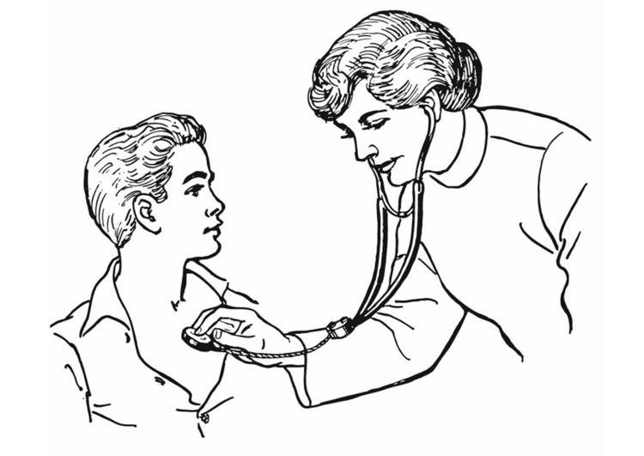
Inspecting Type Members
Live Demo

Slide 16
Classes in the MemberInfo Hierarchy
System.Reflection.MemberInfo
System.Reflection.EventInfo
System.Reflection.FieldInfo
System.Reflection.MethodBase
System.Reflection.ConstructorInfo
System.Reflection.MethodInfo
System.Reflection.PropertyInfo
System.Type

Slide 17
Inspecting Methods and their Parameters
Type.GetMethod()
Returns the reflection of a given method
MethodInfo.GetParameters()
Extracts the method’s parameters
MethodInfo someMethod =
myType.GetMethod("SomeMethod");
foreach(ParameterInfo param in
someMethod.GetParameters())
{
Console.WriteLine(param.ParameterType);
}

Slide 18
Dynamic Method Invocation (Late Binding)
We create type object instance by the Activator class
CreateInstance(…)
Creates an instance of given type specified as Type object or string
CreateComInstanceFrom(…)
Creates COM object instance
System.MethodInfo.Invoke(…)
Dynamically invokes a method

Slide 19
Dynamic Method Invocation – Example
// Load the assembly mscorlib.dll
Assembly mscorlibAssembly =
Assembly.Load("mscorlib.dll");
// Create an instance of DateTime by calling
// new DateTime(2010, 1, 5)
Type systemDateTimeType =
mscorlibAssembly.GetType("System.DateTime");
object[] constructorParams =
new object[] {2010, 1, 5};
object dateTimeInstance = Activator.CreateInstance(
systemDateTimeType, constructorParams);
// the example continues

Slide 20
Dynamic Method Invocation – Example (2)
// Invoke DateTime.AddDays(10)
Type[] addDaysParamsTypes =
new Type[] {typeof(System.Double)};
MethodInfo addDaysMethod = systemDateTimeType.
GetMethod("AddDays", addDaysParamsTypes);
object[] addDaysParams = new object[] { 10 };
object newDateTimeInst = addDaysMethod.Invoke(
dateTimeInstance, addDaysParams);
// Get the value of the property "Date" and print it
PropertyInfo datePropertyInfo =
systemDateTimeType.GetProperty("Date");
object datePropValue = datePropertyInfo.GetValue(
newDateTimeInst, null);
Console.WriteLine("{0:dd.MM.yyyy}", datePropValue);

Slide 21

Dynamic Method Invocation
Live Demo

Slide 22
Reflection and Generics
.NET reflection supports generics
Can get the generic parameters at runtime
Some of the generic reflection APIs:
MethodInfo.IsGenericMethod()
MethodInfo.GetGenericArguments()
Type.IsGenericType()
Type.GetGenericTypeDefinition()
…

Slide 23
Real World Example
Live Demo

Slide 24
Reflection
?
?
?
?
?
Questions?
?
?
?
?
?
http://academy.telerik.com

